Slide 1
Introduction to Sea Partners
The Coast Guard’s Environmental Outreach Program

Slide 2
What is Sea Partners?
The Sea Partners Campaign is an environmental education and outreach program focused on communities to develop community awareness of maritime pollution issues and to improve compliance with marine environmental protection laws and regulations.

Slide 3
What is Sea Partners?
Sea Partners is the only Coast Guard initiative to meet the Coast Guard’s legacy obligations for public education under the:
Marine Plastic Pollution Research and Control Act
The Atlantic Protected Living Marine Resource Initiative
The Coral Reef Task Force
The Interagency Marine Debris Coordinating Committee
The Whitewater to Bluewater Initiative

Slide 4
Goals of the Sea Partners Campaign
Increase compliance with Marine Environmental Protection (MEP) laws and regulations by educating waterways users on how those laws affect them.
Raise community awareness of marine pollution issues.
Prevent discharge of marine pollutants.
Increase citizen reporting of marine pollution by publicizing the National Response Center spill reporting number:
800-424-8802

Slide 5
Sea Partners History
Established in 1994 and remains the only environmental public education program in the Coast Guard.
During 1997, the Coast Guard expanded the program to the Coast Guard Auxiliary. Auxiliarists are encouraged to earn a Prevention Outreach Specialist qualification to better prepare them in conducting Sea Partners events.

Slide 6
Legislative Authority
The primary legislative authority for the Sea Partners Campaign comes from the Marine Plastic Pollution Research and Control Act of 1987, which requires the Coast Guard to conduct a public outreach program regarding:
The harmful effects of plastic pollution
The need to reduce such pollution
The need to recycle plastic materials
The need to reduce the quantity of plastic debris in the marine environment

Slide 7
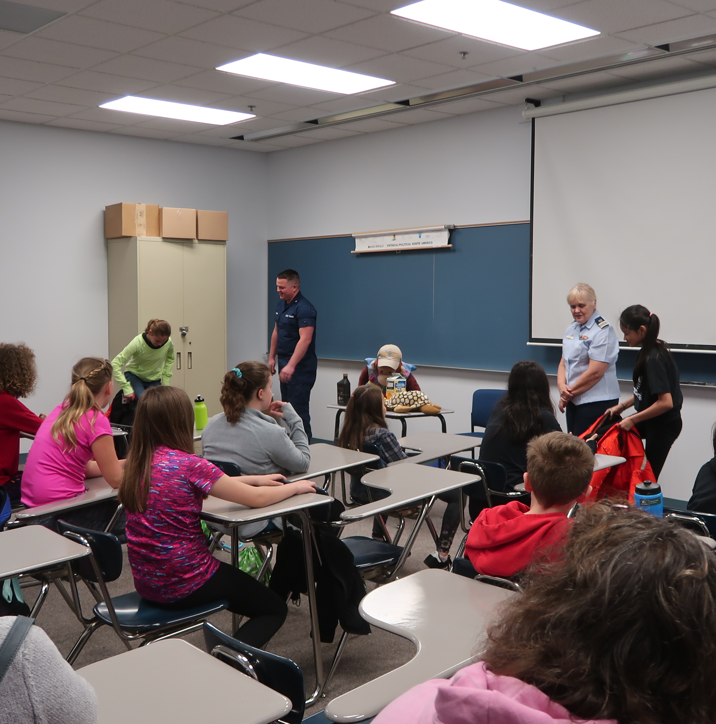
Sea Partners Presentations
Sea Partners can be presented at these events:
Classroom settings
Boat Shows
Boating Safety Classes
Workshops with interest groups
Public Service Announcements
Distribution of leaflets and posters
Other appropriate means

Slide 8
Uniform of the Day for Sea Partners Events
Indoor events: Tropical Blue
Outdoor events: ODU or AWU
Active Duty uniform is determined by the Sector or Station (usually ODU)
Members that do not yet have uniforms may work at the event in proper civilian apparel. (See AUXMAN chapter 10)
Uniforms should be clean and pressed, in good working condition. If uniform becomes worn or unusable it needs to be replaced prior to working a Sea Partner event.

Slide 9
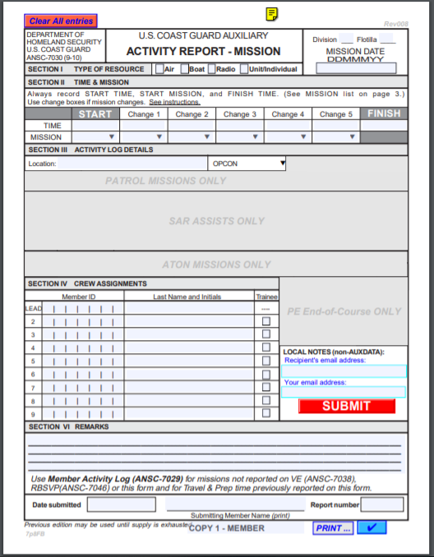
Recording Sea Partner Hours in AUXDATA
Hours for Sea Partner events are entered on an ANSC-7030 form, using Mission Code 70N
Travel time, prep time, mileage, and expenses goes on an ANSC-7029 form, using Mission Code 99C
Sea Partner hours must be recorded on a 7030 form in order to count toward work on the Marine Safety badge. Only verifiable 7030 mission hours are allowed to be used toward the required 96 hours per year.

Slide 10
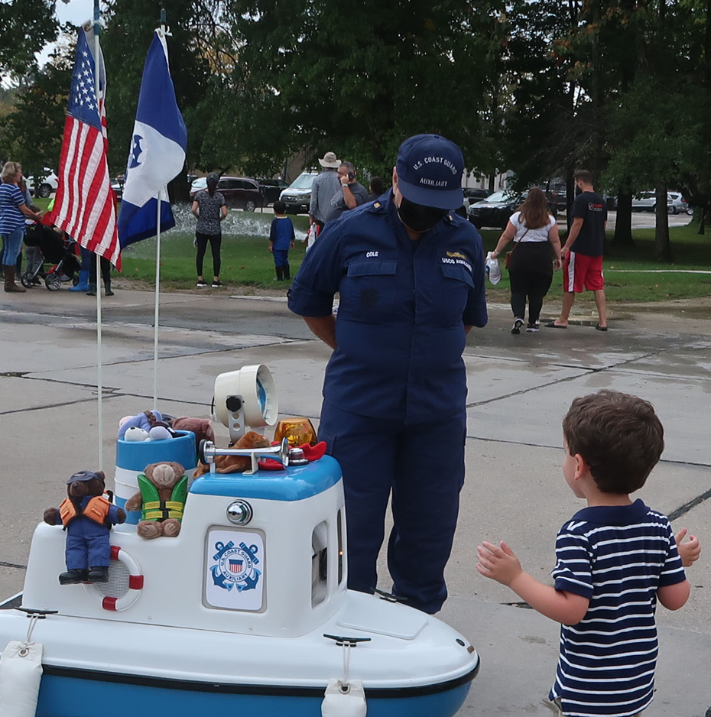
Successful Sea Partners Events
Working with members from other areas (i.e., Public Affairs) can help in having a successful Sea Partner event.

Slide 11
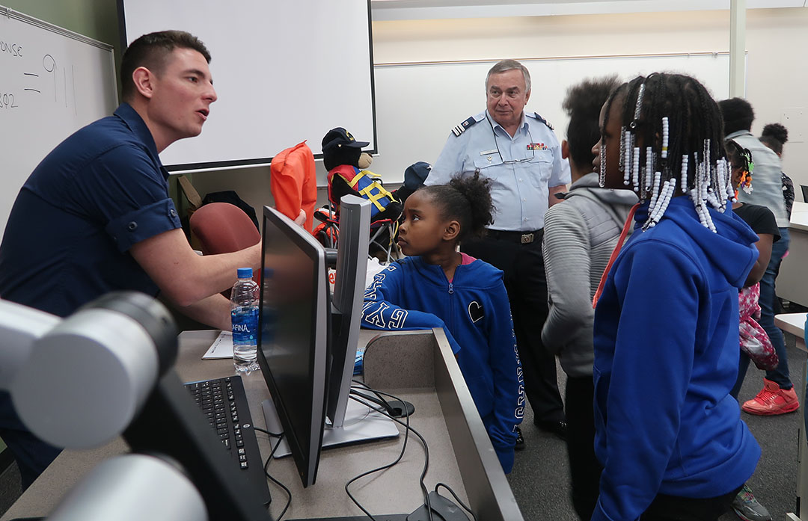
Successful Sea Partners Events
Discussing boating safety, safety on and around the water, along with the Sea Partner mission of discussing water pollution, effects of pollution on the water, etc., makes for a successful event.

Slide 12
Sea Partners Materials
Materials for use at events can be found at the Auxiliary National Supply Center (ANSC)
http://cgaux.org/members/ANSC_Catalog_Jan%202021.pdf
Online materials can be found on the National Prevention webpage:
http://wow.uscgaux.info/content.php?unit=P-DEPT

Slide 13
Sea Partner Materials: Trash Game
Make a Trash Game for use at events. Instructions: http://wow.uscgaux.info/Uploads_wowII/P-DEPT/pdfs/Trash_Game_Construction.pdf

Slide 14
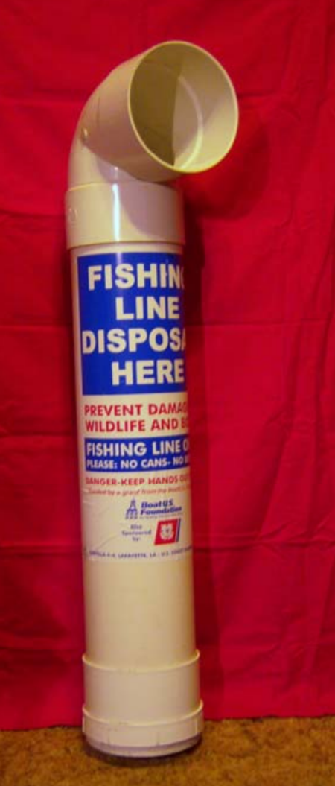
Sea Partner Materials: Monofilament Line Disposal Station
Make monofilament fishing line disposal stations for installation near boat launch ramps.
Instructions: http://wow.uscgaux.info/Uploads_wowII/P-DEPT/pdfs/fishing_line_disposal_station.pdf

Slide 15
Questions?
If you have questions on how to join Sea Partners or how to have your own Sea Partner event, contact your Flotilla Staff Officer for Marine Safety for details on how to get started.
Presentation photo credits: Kristen Iglesias, District 9 Central. Unmasked photos taken prior to COVID protocols.

