Slide 1
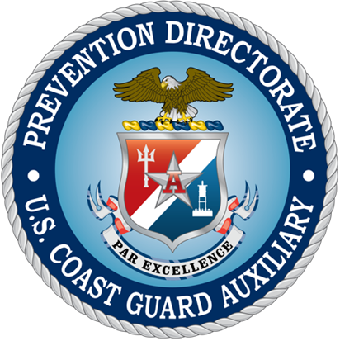
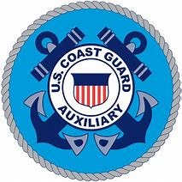
Missions
of the
Auxiliary Prevention Directorate
Auxiliary University Program

Slide 2
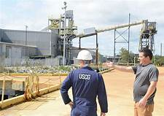
Welcome to
Marine Safety
The Marine Safety Branch of the Prevention Directorate is a growing field of interest. Members performing in many of these areas can expect to work directly with Active Duty on Coast Guard missions.
There are several Marine Safety qualifications to choose from that allow members to provide needed missions support.
The next few slides touch upon some of the most important missions of the Coast Guard Auxiliary in the Marine Safety fields.
Note: click on underlined sections to follow online links.

Slide 3
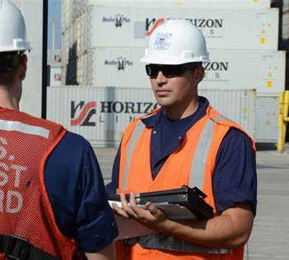
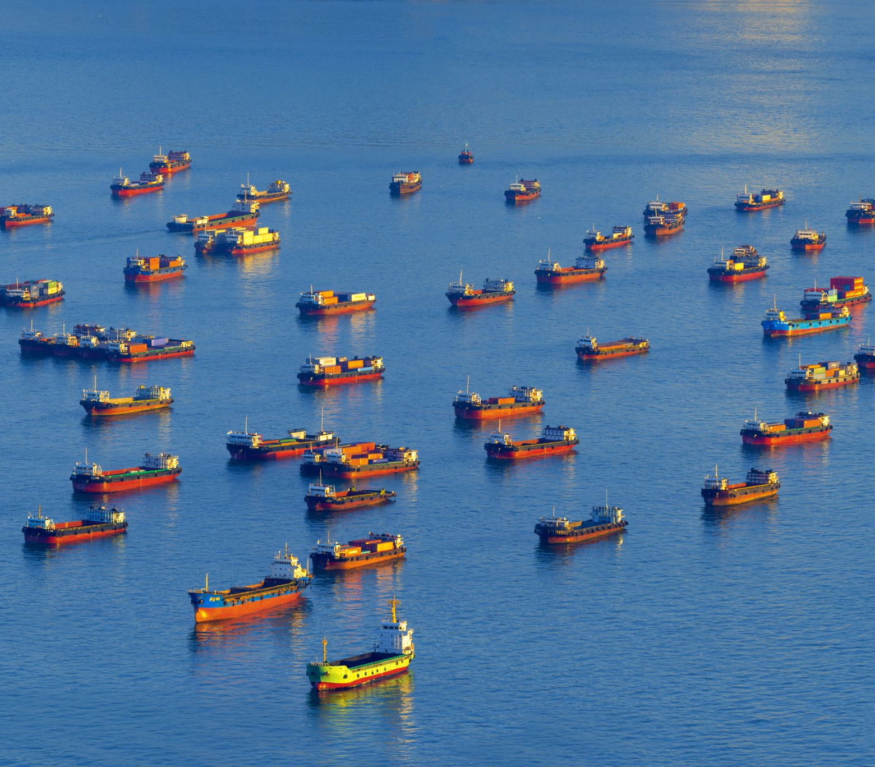
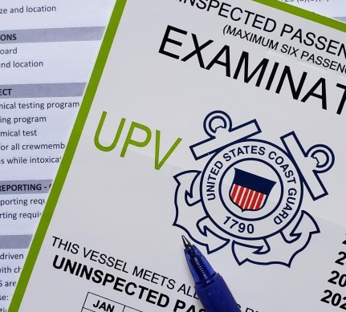
Branches
of the
Prevention Directorate
There are four branches of the Prevention Directorate devoted to Marine Safety:
Commercial Vessel Activity
Uninspected Vessel Activity
Prevention Outreach
Communication & Education Support
Assistance is always needed in all four of these areas. Members in many of these fields work side-by-side with Active Duty and Reserves within Sector Marine Safety Departments (MSDs) and Marine Safety Units (MSUs), engaging with both the public and the commercial fishing industry.

Slide 4
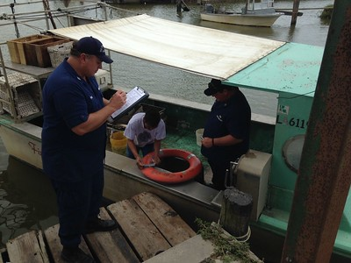
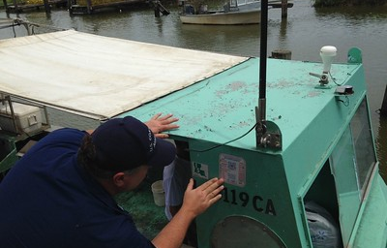
Commercial Fishing
Vessel Examiner
Uninspected Passenger
Vessel Examiner
Two highly sought-after qualifications of the Marine Safety branch involve commercial vessels.
These qualifications allow an Auxiliarist to perform courtesy safety exams for commercial fishing and passenger vessels. Monitoring safety standards, protecting the public, and preserving the health and welfare of the commercial fishing workforce are the goals of an examiner.
The need for both of these qualifications is reflected in GAP analyses that are periodically completed by Sectors that indicate areas for which each Sector most often requests support from the Auxiliary.

Slide 5
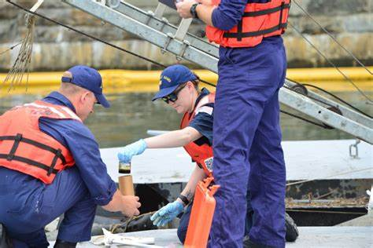
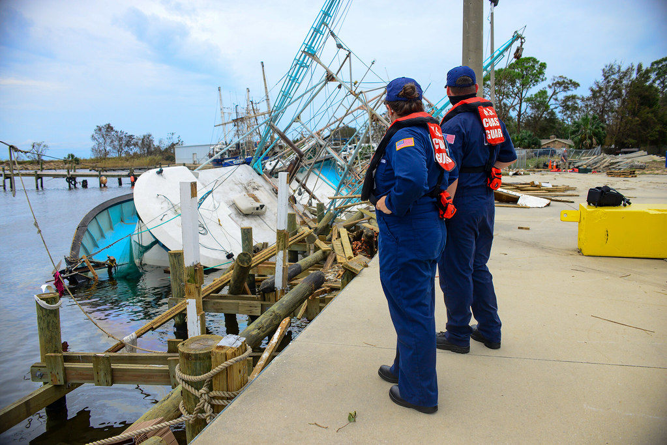
Pollution
Responder
Pollution Responder is one of the most frequently utilized qualifications for the Auxiliary in all Coast Guard Sectors.
Auxiliary Pollution Responders find themselves doing numerous activities such as taking samples, keeping notes during investigations, and providing security perimeters for oil cleanup teams.
A member’s activities will be determined by the Active Duty they work alongside on a spill response. Different Sectors may have different assignments for Auxiliarists.

Slide 6
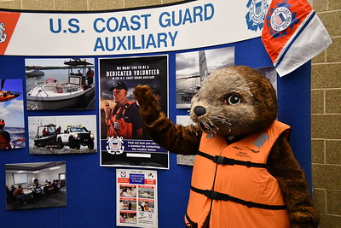
Sea Partners
Any Auxiliarist can participate in Sea Partners, an outreach program designed to inform the public about the harmful impacts of water pollution. There are no prerequisites---just a passion for the mission and the desire to succeed! While not required, the AUX-MEES qualification (see page 9 of this presentation) is highly recommended and encouraged.
Sea Partners missions include presentations at recreational venues such as boating/fishing events,
and engaging with environmental groups.
As kids are the keys to the future of pollution prevention, the majority of Sea Partners missions provide prime opportunities for members to inspire children in classrooms, at school events, and at other youth-friendly happenings like water festivals!

Slide 7
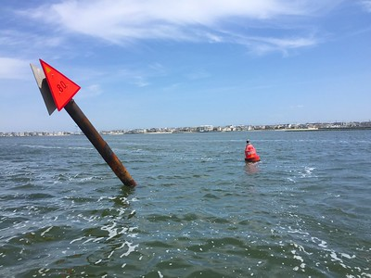
Navigation Systems
Members pursuing Navigation Systems training learn the proper procedures for verifying Aids to Navigation (ATON), bridges, and chart updating.
Training in this branch requires working with an Auxiliary Verifying Officer (VO) toward successful completion of the ATON Verifier PQS workbook:
An ATON Verifying / Chart Updating C-School is available to a limited number of accepted members each year as an opportunity to learn in a formal classroom environment, in addition to completing the required PQS.*
*Attending the C-School does not earn the member a Letter of Designation (LOD). The member must still successfully complete the required sign-offs in the PQS workbook.
ATON Verifier Performance Qualification Standard (AV PQS) Booklet

Slide 8
Qualifications in the Prevention Directorate
A wide range of Performance Qualification Standards (PQSs) can be found on the National Prevention website. Log-in to browse the various missions, requirements, and PQS workbooks. The website contains valuable materials and presentations for Auxiliary use.
Training for these qualifications is arranged through your chain of leadership (COL) in the Marine Safety Branch of the Auxiliary and Active Duty Marine Safety Departments (MSDs) at local Sectors. Upon completion of all required items, the member can provide direct support to the Coast Guard.

Slide 9
Auxiliary-Specific
Qualifications
AUX-MSAM and AUX-MEES educate members about the day-to-day workings of the Coast Guard, and the roles of both the Coast Guard and the Auxiliary in pollution prevention and environmental protection, respectively.
Earning these qualifications provides broad knowledge about the CG and Auxiliary that can be used for presentations to fellow Auxiliary members at meetings and events, as well as public education.
These qualifications are earned by working with qualified Auxiliary members and the local DIRAUX.
Marine Safety
Administrative Management
(AUX-MSAM)
Prevention Outreach
(AUX-MEES)

Slide 10
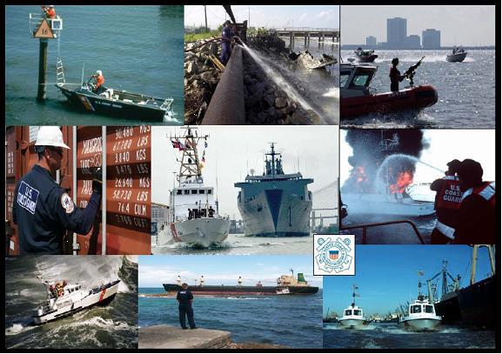
Online Courses
Two highly informative online courses that are required for a number of qualifications are also found on the Prevention Directorate website:
Introduction to Marine Safety
and Environmental Protection (IMSEP)
Designed to educate Active Duty, Reserve, Auxiliary and Civil Service about the Marine Safety structure, history, missions and programs of the U.S. Coast Guard
Good Mate
Learn about water pollution and how
to prevent it through “Clean Boating” awareness and practices
Follow the links to access relevant manuals

Slide 11
Marine Safety
Training Programs
Training in the Marine Safety branch of the Auxiliary can take a few months to over a year, depending on the particular mission. Performance Qualification Standards (PQS) workbooks for each mission can be found on the Prevention National webpage.
Completion of PQS workbooks must be accomplished by working with Verifying Officers (VOs). These can be Active Duty personnel or qualified Auxiliarists who hold the Letter of Designation (LOD) in the chosen field. Keep in mind that not all qualifications are available at all Sectors.
Contact your Flotilla Staff Officer for Marine Safety (FSO-MS) to find out which qualifications are available at your Sector, and how to get started!

Slide 12
Letter
of
Designation
Obtaining a Letter of Designation (LOD) is the final step toward qualification. Once all PQS workbook sign-offs are completed, you must pass an oral board, after which you can be recommended for a Letter Of Designation qualifying you to work in the specified field alongside Active Duty personnel (to the extent defined by the mission). The LOD will be signed by either the Captain of the Port (COTP) or DIRAUX.

Slide 13
Emblems Signifying Service in the
Prevention Directorate Marine Safety Branch
Marine Safety Training Ribbon
(Program Ribbon)
Marine Safety Insignia
(Qualified MS Member)
Follow the links provided for information on how to earn the ribbon and the insignia

Slide 14
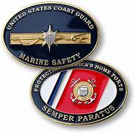
Prevention Directorate
Email Us
Prevention National Website

